Slide 1
Library-Computer-Usage-Analysis
Brown Biggers • Michael Ellis Nickolas Lloyd • Patricia Tanzer

Slide 2
Overall goals:
What criteria lead to the best placement of public access machines in the library?
What effect, if any, do changes in configuration, location, and outside elements have on usage?
Can a better solution be derived from analysis of data and machine learning?

Slide 3
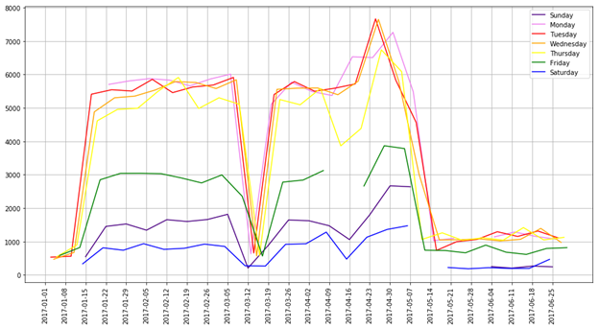
Gate Counts with Semester Schedule
01/17/17, Tues: Classes begin
03/11/17, Sat: Spring Break begins
03/20/17, Mon: Spring Break ends
04/14/2017, Fri: Holiday
05/03/17, Wed: Reading Day
05/04/17, Thurs: Finals start
05/12/17, Fri: Commencement

Slide 4
Future Goals
Nick: Hypothesis testing
Brown: Bookeh interactive graphs
Patti: Finish Presentation docx, powerpoint
Michael: Visualization of Weather codes

